Slide 1
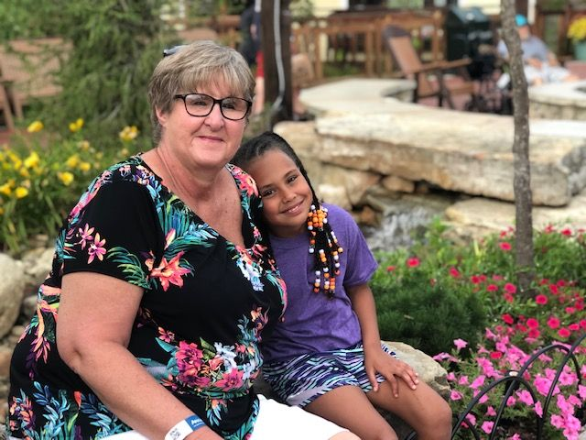
Hello! I am Kim Fowler, and I have taught at Daughtry for the last 17 years! I live in Milner with my daughter and granddaughter. I also have a French Bulldog named Rollie and a cat named Wiz. My granddaughter Lanie, and the pets keep my very busy! I love
Alabama Football! Roll Tide! :-)
Add a
picture here.
Galloping to Greatness!
I am pleased to welcome you to the 2020-2021 school year! I am looking forward to having your child as a student! 5th grade is a fantastic year with so many learning activities to celebrate. In order to have a great year, my most important goal is to build relationships. I want to create a family of learners in my class. Your child will be valued, trusted, and be an integral part in this process. In order to accomplish this, I welcome you to contact me with any questions, concerns or comments you may have.
Email: fowlerk@bcssk12.org
Phone: 770-504-2356
Website: https:bcssk12.org/DES
Join Remind for updates and information. Text the message @gh2cba to the number
81010.

